Slide 1


Server-Client Messenger

Slide 2
Introduction
Server-Client Messenger is a chat application which handle multiple users at the same time.
It is based entirely on Java and consists of two parts: Messenger (client application) and Server (server application).
Features:
1. It handles multiple users at the same time
2. It supports both public and private messages
3. It provides information about online users

Slide 3
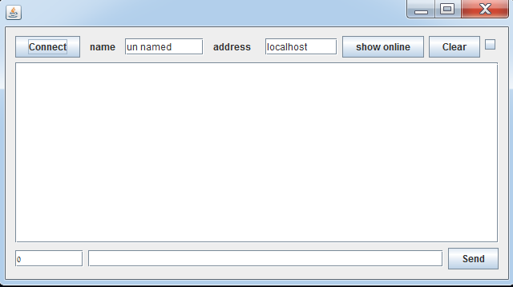
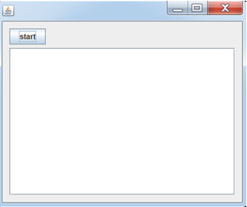
User Interface (UI)
Client Application
Server Application

Slide 4
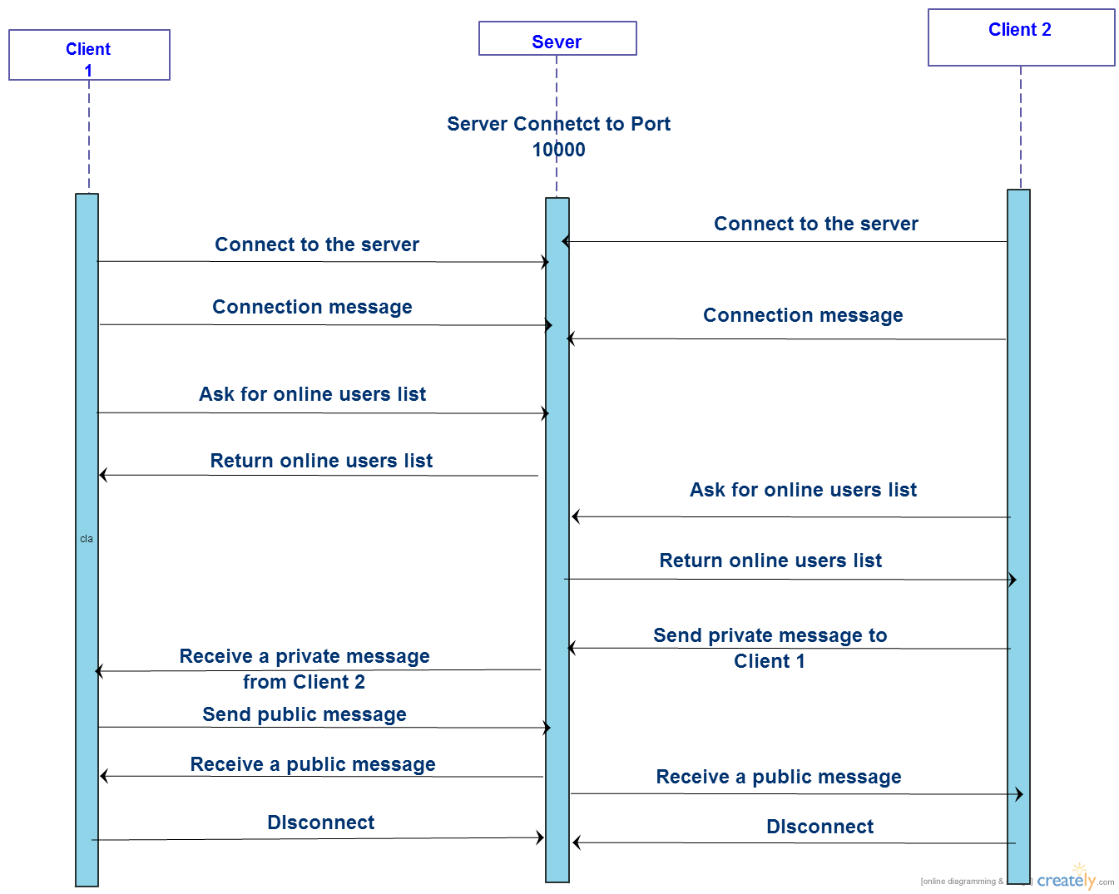
UML sequence diagram

Slide 5
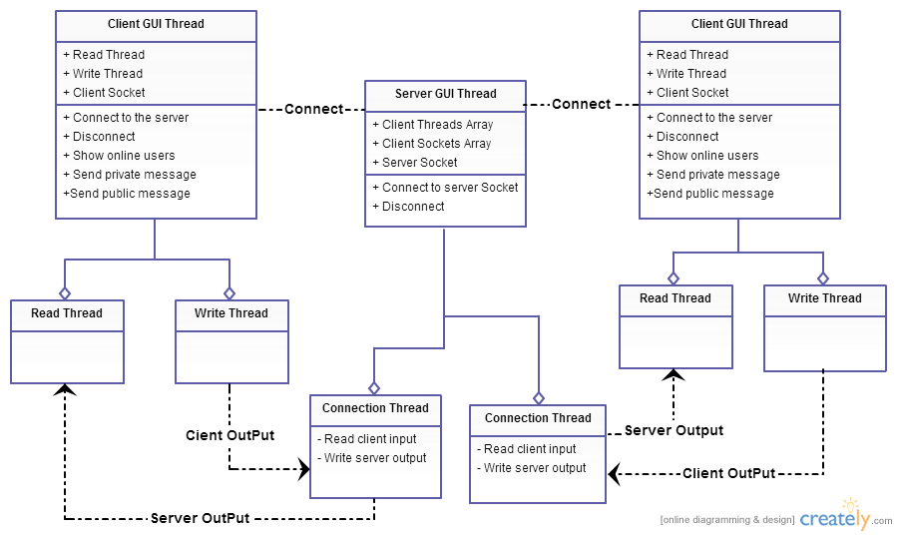
Classes and Threads Diagram

Slide 6




